Slide 1

Modern frontend development with ReactJS
@JozefCipa

Slide 2
ReactJS
V in MVC, solves UI layer
Virtual DOM, diffing algorithm
library, not framework
component based
declarative approach
ES6 => Gulp + Babel compiler
by Facebook

Slide 3
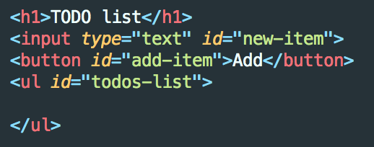
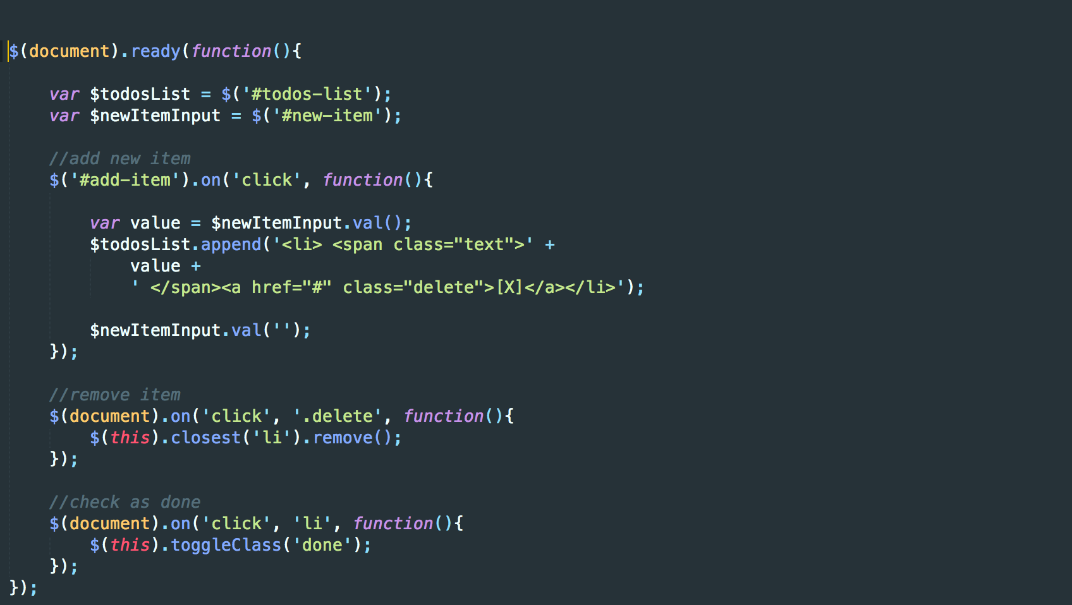

Slide 4
Why do we need React?
logic separation of code
scalability
speed
project maintainability
team cooperation
“integrates nicely with existing codebases”

Slide 5
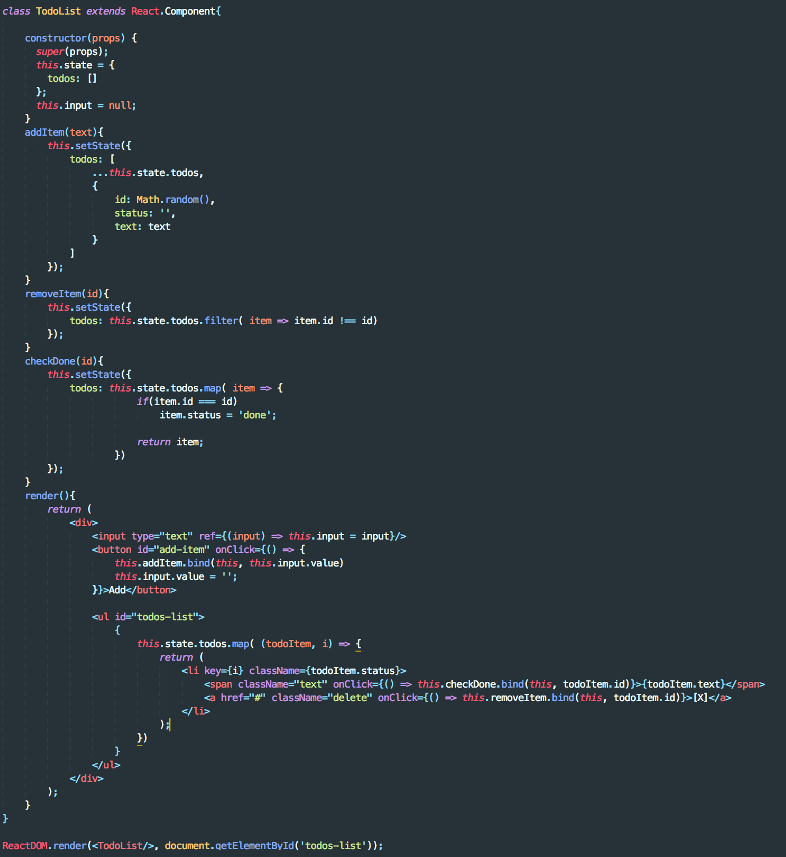
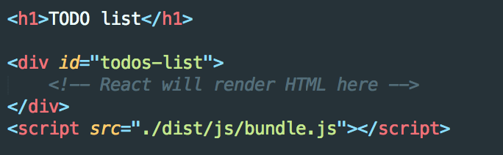

Slide 6
React.Component
basic part of UI
reusable
independent
class or pure function
https://facebook.github.io/react/docs/react-component.html

Slide 7
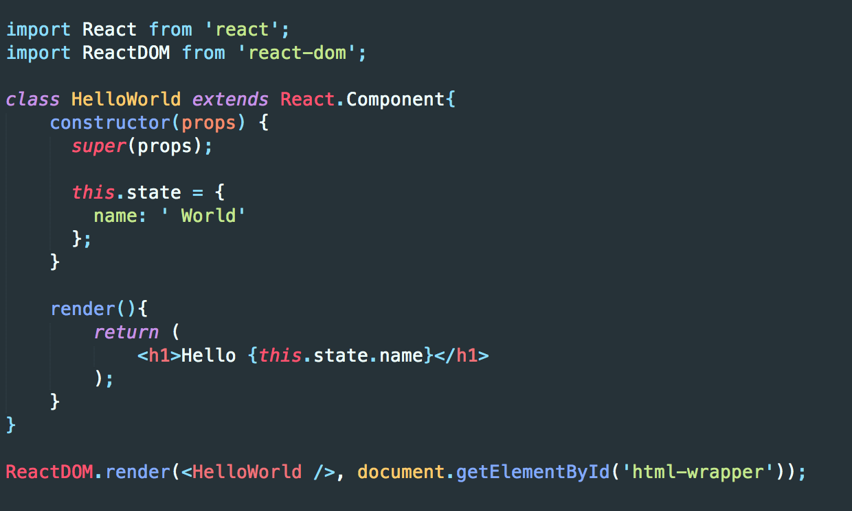

Slide 8
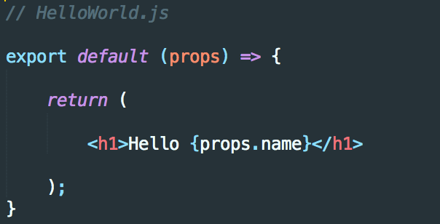

Slide 9
state vs. props
props
data from outside
read-only
state
data specific to component
data update = component re-rendering
“If you don't use it in render(), it shouldn't be on the state”

Slide 10
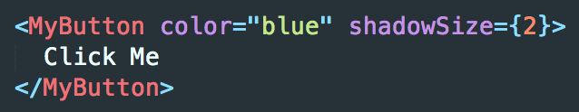
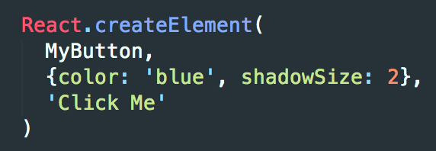
JSX != HTML

Slide 11
Data flow and Flux
MVC
FLUX

Slide 12
Redux
state container
Three principles
Single source of truth
State is read-only
Changes are made with pure functions

Slide 13
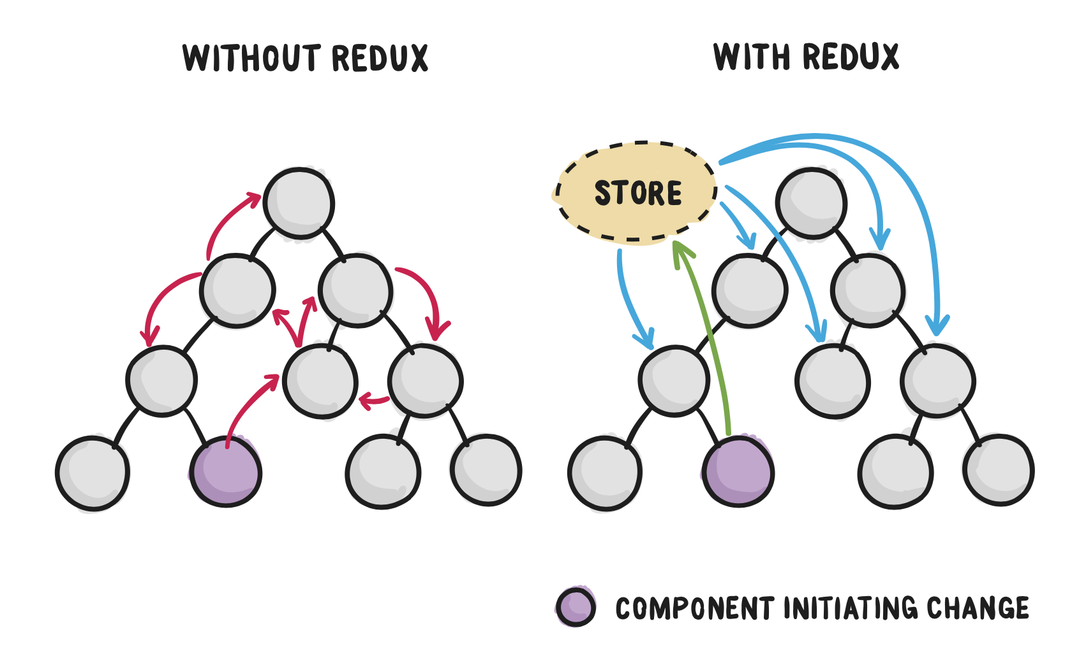

Slide 14
Component types in Redux
“A container does data fetching and then renders its corresponding sub-component. That’s it.”
Container components
deal with data
Presentational components
data and functions passed as props
just render view

Slide 15
TODO v3
React + Redux

Slide 16
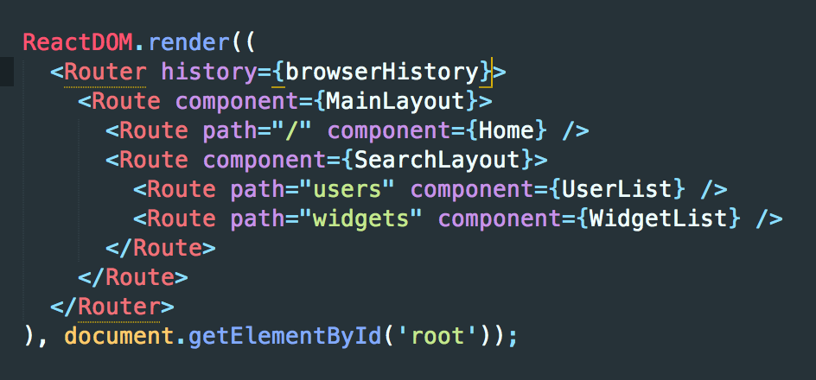
Routing

Slide 17
Server side rendering
performance
speed
to avoid initial data loading
NodeJS, PHP(v8js extension)

Slide 18
React Native
“If you like React on the web, you'll like React Native.”
uses native code, not WebView
UI in separate thread
native components support
Flexbox styling

Slide 19
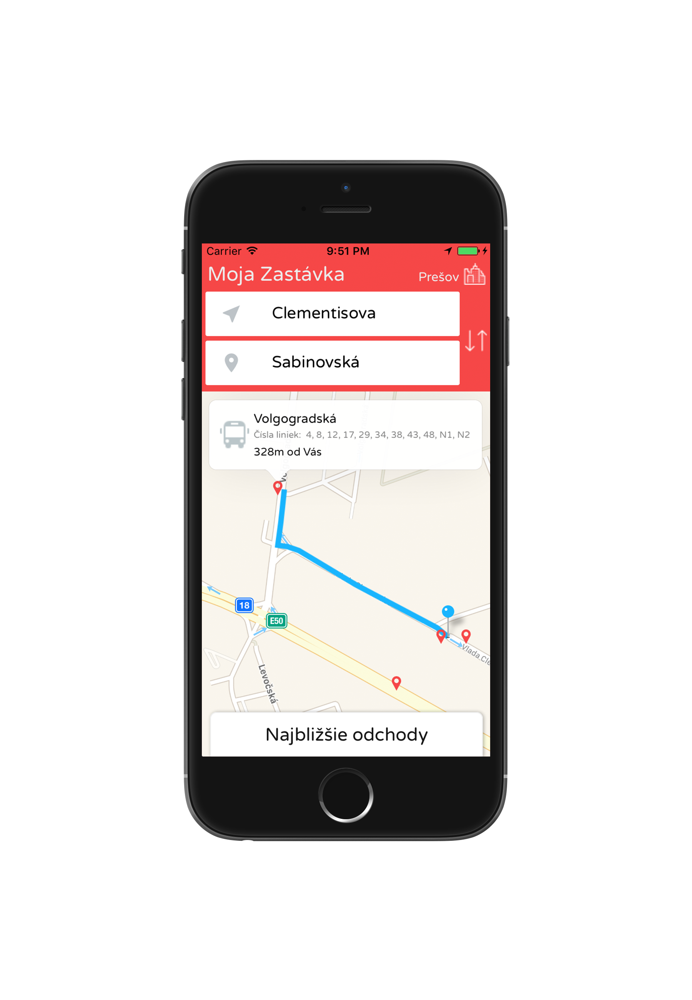
Moja Zastávka
Finds stops in your destination
React native & Redux
ES6
Google API
2017
http://apple.co/2nAHBte

Slide 20
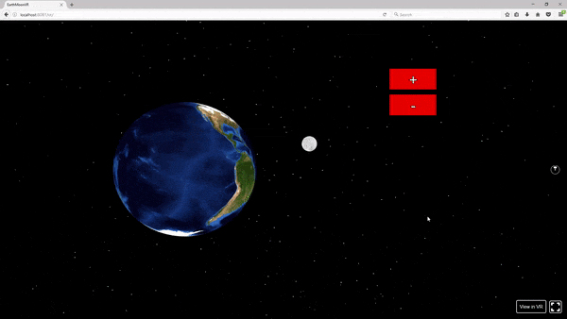
ReactVR
Three.js
WebGL
View, Image, Text, Pano, Mesh, PointLight
Flexbox layout

Slide 21


Slide 22
Q & A
github.com/JozefCipa

Slide 23
Resources
https://facebook.github.io/react/docs/hello-world.html
https://www.gitbook.com/book/developmentarc/react-indepth/details
https://css-tricks.com/learning-react-router/
https://css-tricks.com/learning-react-container-components/
https://css-tricks.com/learning-react-redux/
https://www.pluralsight.com/guides/front-end-javascript/getting-started-with-react-vr
http://redux.js.org/docs/introduction/ThreePrinciples.html
https://vacuumlabs.com/blog/7-strengths-of-react-every-programmer-should-know-about
https://react.parts/

